Slide 1



Department of Artificial Intelligence and Data Science
ENERGYWISE: PREDICTING ENERGY CONSUMPTION FOR A GREENER TOMORROW
PRIADHARSHNI P (221801039)
PRIYADARSHINI S (221801040)
VENKATESAN T (221801061)

Slide 2
PROBLEM STATEMENT AND MOTIVATION
Develop a forecasting model that accurately predicts energy consumption for residential and commercial buildings using historical data, weather forecasts, and occupancy information.
MOTIVATION:
Accurate energy consumption forecasting allows users to manage their energy usage more efficiently, reducing unexpected high bills and promoting smarter energy consumption practices.
Effective forecasting helps in optimizing resource allocation, reducing energy waste, and supporting cost savings, while also contributing to environmental sustainability by encouraging responsible energy use and reducing carbon footprints.
www.reallygreatsite.com
PAGE: 03

Slide 3
OBJECTIVES
To accurately forecast and predict energy consumption for residential buildings, helping households make smarter decisions, save money, and contribute to a greener planet effortlessly.
Precise Residential Energy Forecasting:
Predict daily household energy consumption with high accuracy.
Smart Alerts and Notifications:
Receive real-time tips and alerts to optimize energy usage and prevent waste.
Actionable Energy Insights:
Gain a deeper understanding of energy habits and make informed decisions to reduce energy waste and improve efficiency.
PAGE: 08

Slide 4

ABSTRACT
The EnergyWise energy consumption monitoring system uses the XGBoost algorithm to accurately predict energy usage in residential and commercial buildings by analyzing historical data, weather forecasts, and occupancy patterns. With real-time insights and an intuitive interface, users can optimize their electricity consumption, reduce costs, and lower their carbon footprint. The system ensures data security, offers remote access for monitoring from any location, and provides dynamic visualizations and historical trends for informed decision-making. By promoting energy-efficient practices, EnergyWise supports environmental sustainability and helps users contribute to a greener future. Additionally, it delivers personalized smart alerts and recommendations to further optimize energy usage and prevent excessive consumption.
www.reallygreatsite.com
PAGE: 04

Slide 5

INTRODUCTION AND OVERVIEW OF THE PROJECT
INTRODUCTION:
Our goal is to develop a forecasting model to predict future energy consumption in residential and commercial building based on historical usage data, weather conditions and occupant information in order to reduce cost and to predict future energy usage accurately.
OVERVIEW:
EnergyWise is designed to address the issue of unexpected high electricity bills faced by households and businesses. By accurately predicting energy consumption in advance can help users to plan better and manage costs effectively. The project leverages the XGBoost algorithm to provide precise daily energy usage predictions, enabling users to make informed decisions, optimize energy use, and support sustainability efforts.
www.reallygreatsite.com
PAGE: 01

Slide 6
LITERATURE SURVEY
S. NO | AUTHOR NAME | PAPER TITLE | DESCRIPTION | VOLUME/YEAR
1 | 1.Md Farhad Hossain 2. Nor Azwadi Che Sidik 3. Md Mahmudul Hasan | Energy Consumption Prediction by Using Machine Learning for Smart Buildings. | This paper uses k-Nearest Neighbors (k-NN), Support Vector Machines (SVM), and Artificial Neural Networks (ANN) to predict energy consumption based on historical IoT data in a commercial building. It provides insights into the accuracy and effectiveness on improving energy management. | 2021
2 | 1.A.Abdelaziz 2.M.Youseff 3. A. Salem 4.M. Ismail | Prediction of Energy Consumption in Campus Buildings Using Machine Learning Techniques | The paper presents a machine learning-based model that utilizes historical data and environmental conditions to forecast energy consumption in campus buildings. The study primarily uses the XGBoost algorithm for prediction and optimization. | 2023
PAGE: 03

Slide 7
LITERATURE SURVEY
S. NO | AUTHOR NAME | PAPER TITLE | DESCRIPTION | VOLUME/YEAR
3 | 1.A. Smith 2. Johnson 3. Williams | Accurate Prediction of Hourly Energy Consumption in a Residential Building | This paper develops a deep neural network-based algorithm to predict energy consumption in residential buildings. The model incorporates occupancy rates and improves upon traditional models such as extreme gradient boosting, multiple linear regression, and shallow artificial networks. | 2021
4 | 1.M.C. Pegalajar 2. L.G.B. Ruiz | Time Series Forecasting for Energy Consumption | This paper presents time series forecasting models for energy consumption. The models are applied to energy-related time series data to predict consumption. Deep learning and artificial neural networks were extensively used to improve the accuracy of predictions. | 2022
03

Slide 8
LITERATURE SURVEY
S. NO | AUTHOR NAME | PAPER TITLE | DESCRIPTION | VOLUME/YEAR
5 | 1.Mathieu Bourdeau 2.Xiaoqiang 3. Elyes Nefzaoui 4. Xiaofeng Guo | Modeling and forecasting building energy consumption: A review of data-driven techniques | This paper reviews algorithms like Autoregressive Models (ARIMA, SARIMA) for forecasting using historical data, Artificial Neural Networks (ANN, RNN, DNN) for capturing patterns in both historical and real-time data, and Support Vector Machines (SVM) for finding optimal prediction boundaries from historical data. | 2019
03

Slide 9
EXISTING SYSTEM
Traditional energy consumption monitoring systems rely on manual tracking and basic analytics, offering users only a summary of their overall energy usage. These systems mainly focus on historical data without the ability to forecast future energy consumption. While some advanced systems offer real-time monitoring, they typically lack device-level tracking and fail to account for key factors like weather conditions and occupancy patterns, limiting their ability to provide actionable insights for optimizing energy use. This lack of precision prevents users from effectively managing energy consumption and reducing costs. Additionally, the absence of predictive capabilities leads to missed opportunities for more sustainable energy practices. Consequently, users are often left with higher energy bills and inefficient energy use.
PAGE: 08

Slide 10
DRAWBACKS OF EXISTING SYSTEM
Limited Forecasting Ability: They focus mainly on historical data without the capability to accurately predict future energy consumption, hindering proactive energy management.
Lack of Device-Level Tracking: Most systems do not provide detailed insights into energy usage for individual devices, making it difficult for users to identify which appliances are consuming the most energy.
No Integration of External Factors: These systems typically do not consider key factors such as weather conditions or occupancy patterns, which are crucial for accurate energy predictions and optimization.
Inadequate Actionable Insights: Users receive only general summaries of their energy usage, lacking specific recommendations or smart alerts to optimize their consumption and reduce costs.
Higher Energy Bills: The absence of predictive capabilities and detailed tracking can lead to unexpected spikes in energy consumption and higher bills, as users cannot effectively manage or adjust their usage based on insights.
www.reallygreatsite.com
PAGE: 04

Slide 11
PROPOSED SYSTEM
The proposed EnergyWise system is an advanced energy management solution designed to optimize energy consumption for residential and commercial buildings. It leverages smart meters and environmental sensors to collect real-time data, which is analyzed using the XGBoost algorithm to provide accurate energy consumption forecasts. The system features a user-friendly dashboard that displays real-time data, predictive insights, and personalized recommendations to help users manage their energy use effectively. It ensures data security through robust authentication and encryption, while cloud integration supports scalable data management. By offering precise forecasting, actionable alerts, and advanced analytics, EnergyWise addresses the shortcomings of traditional systems, empowering users to make informed decisions, reduce energy costs, and support environmental sustainability.
www.reallygreatsite.com
PAGE: 04

Slide 12
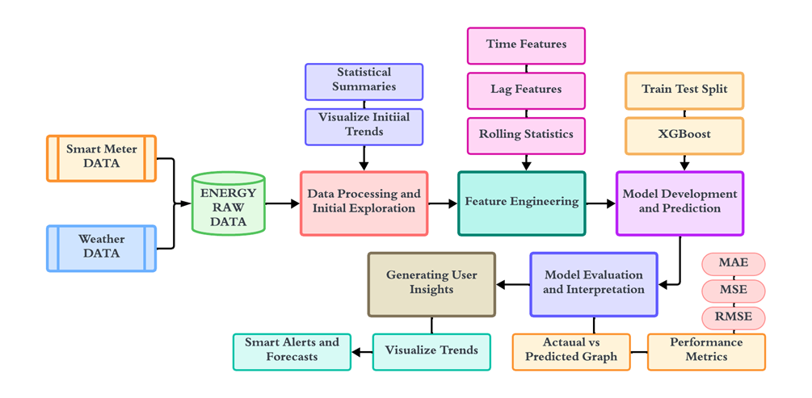
ARCHITECTURE DIAGRAM
www.reallygreatsite.com
PAGE: 03

Slide 13
MODULE 1 - DATA COLLECTION
ALGORITHM:
1. Initialize Sensors: Set up smart meters for energy, and sensors for temperature, humidity, light, noise, and occupancy tracking.
2. Start Data Logging: Continuously collect real-time data from energy meters, environmental sensors, and occupancy trackers.
3. Timestamp Data: Attach unique timestamps to each data point.
4. Store Data: Save data with fields like Device ID, location, sensor type, timestamp, and measured values in a structured format.
5. Transmit Data: Send the collected data to the Data Integration and Pre-processing module for processing.
PAGE: 08

Slide 14
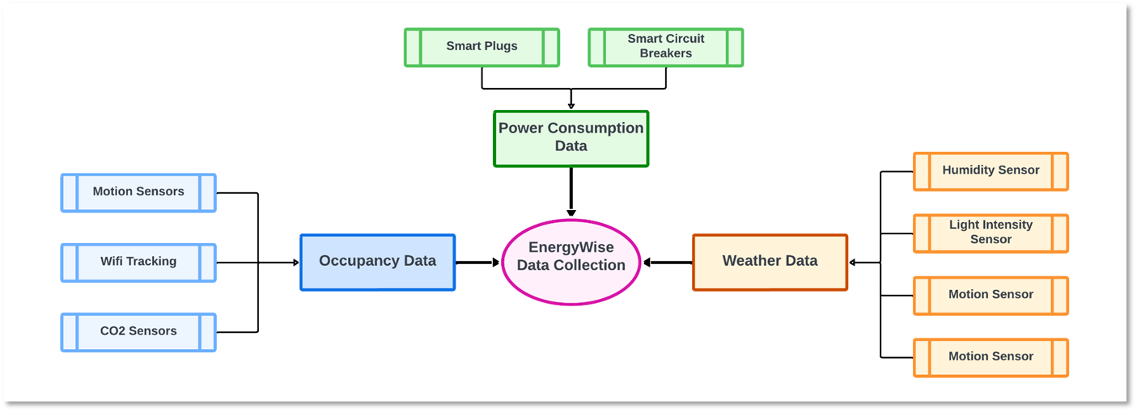
MODULE 1 - DATA COLLECTION
DATA FLOW DIAGRAM
www.reallygreatsite.com
PAGE: 04

Slide 15
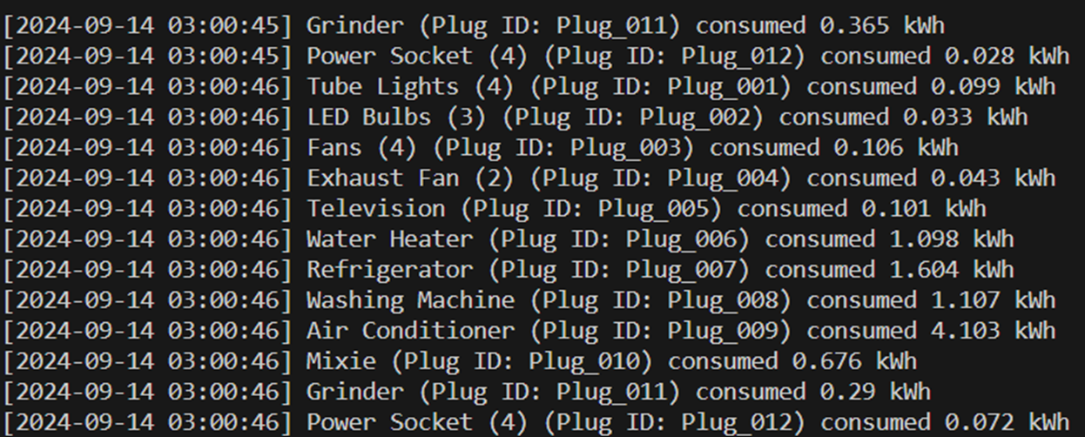
MODULE 1 - DATA COLLECTION
OUTPUT SCREENSHOT:
www.reallygreatsite.com
PAGE: 04

Slide 16
MODULE 2 - DATA INTEGRATION AND PRE-PROCESSING
ALGORITHM:
1.Load Data: Read energy, occupancy, and weather data from CSV files into Data Frames.
2.Preprocess Data: Convert 'Timestamp' columns to datetime and merge the Data Frames. Handle missing values with backward fill and linear interpolation.
3.Normalize Energy Consumption: Use MinMaxScaler to scale 'Energy Consumed (kWh)' between 0 and 1.
4.Add Time-Based Features: Extract the hour from the 'Timestamp' and create flags for peak hours (6-9 AM, 6-9 PM) and high occupancy (occupants > 3).
5.Save and Display: Save the processed Data Frame to a CSV and display key columns with layman-friendly insights.
PAGE: 08

Slide 17
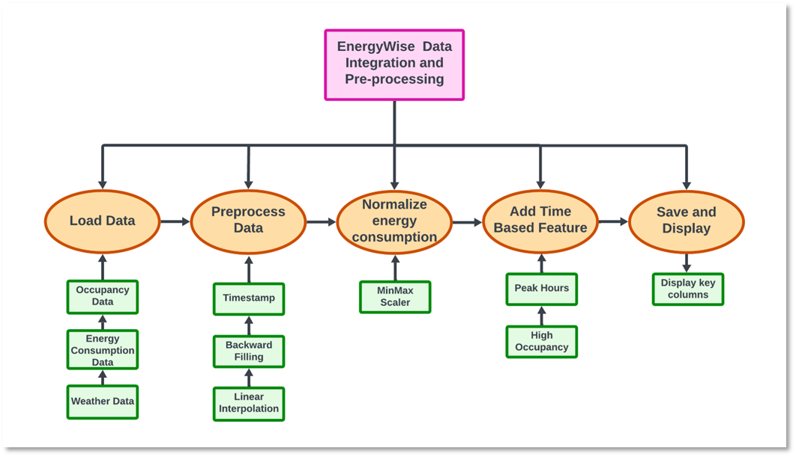
MODULE 2 - DATA INTEGRATION AND PRE-PROCESSING
DATA FLOW DIAGRAM
www.reallygreatsite.com
PAGE: 04

Slide 18
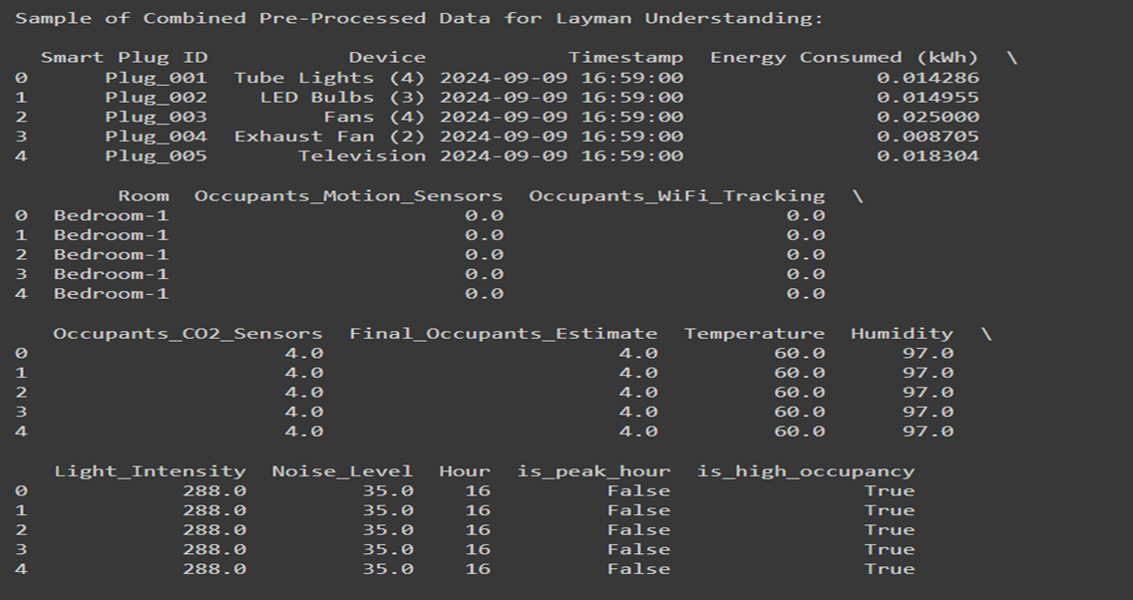
MODULE 2 - DATA INTEGRATION AND PRE-PROCESSING
OUTPUT SCREENSHOT:
www.reallygreatsite.com
PAGE: 04

Slide 19
MODULE 3 - DATA PROCESSING AND REAL-TIME INSIGHTS
ALGORITHM:
1.Select Relevant Features: Choose important features like 'Hour' and the target variable 'energy_consumed' for the model.
2.Split Data: Divide the dataset into training and testing sets for model evaluation.
3.Train XGBoost Model: Build an XGBoost regression model using the training data to predict energy consumption.
4.Evaluate Model: Assess model performance using metrics like RMSE (Root Mean Squared Error) and R² scores to determine accuracy.
5.Highlight Energy Consumption: Analyze and summarize the total energy consumed per device across different time intervals for real-time insights and monitoring.
PAGE: 08

Slide 20
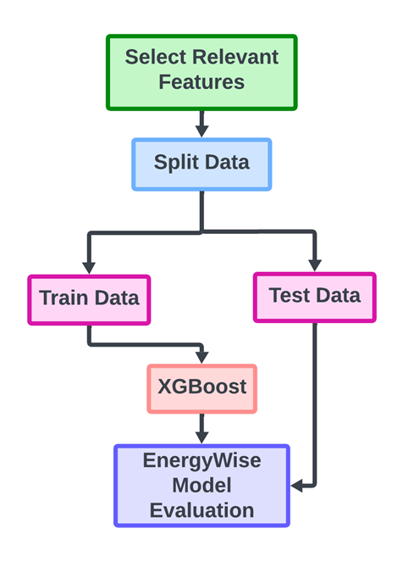
MODULE 3 - DATA PROCESSING AND REAL-TIME INSIGHTS
DATA FLOW DIAGRAM
www.reallygreatsite.com
PAGE: 04

Slide 21
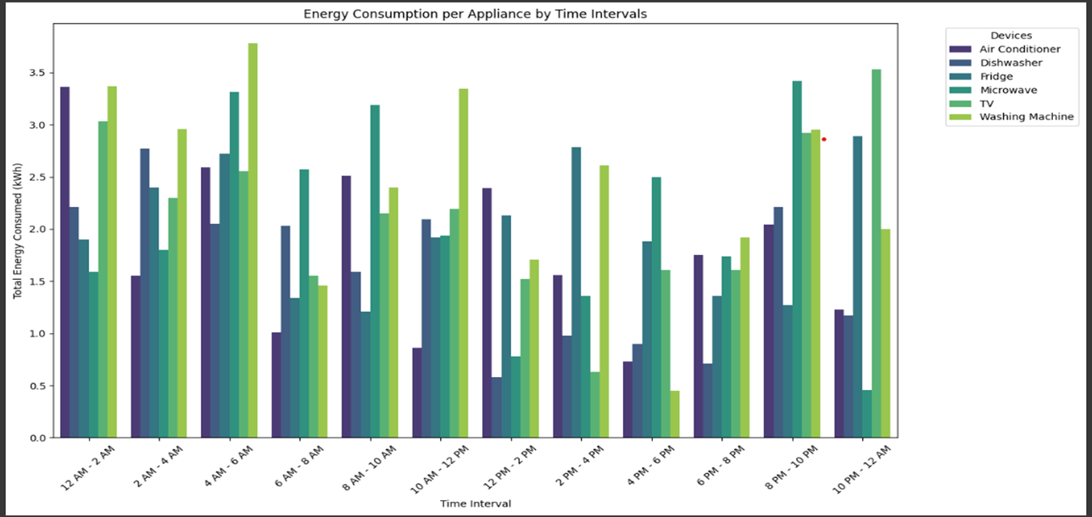
MODULE 3 - DATA PROCESSING AND REAL-TIME INSIGHTS
OUTPUT SCREENSHOT:
www.reallygreatsite.com
PAGE: 04

Slide 22
MODULE 4 - MODEL EVALUATION
ALGORITHM:
1.Extract Features and Labels: Select 'Hour' as the feature (X_test) and 'energy_consumed' as the target label (y_test) from the test dataset.
2.Model Prediction: Use the trained model to predict the energy consumption values (y_pred).
3.Calculate Metrics: Evaluate the model using:RMSE (Root Mean Squared Error) for prediction accuracy.R² score to measure the proportion of variance explained by the model.
4.Compare Results: Create a results DataFrame showing actual vs. predicted energy consumption, along with corresponding timestamps and devices.
5.Display Insights: Print the RMSE, R² scores, and the predicted vs actual energy consumption results.
PAGE: 08

Slide 23
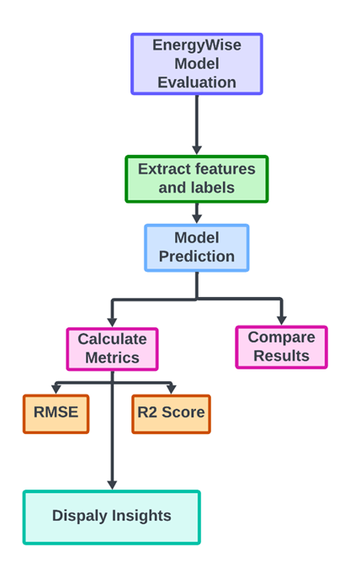
MODULE 4 - MODEL EVALUATION
DATA FLOW DIAGRAM
www.reallygreatsite.com
PAGE: 04

Slide 24
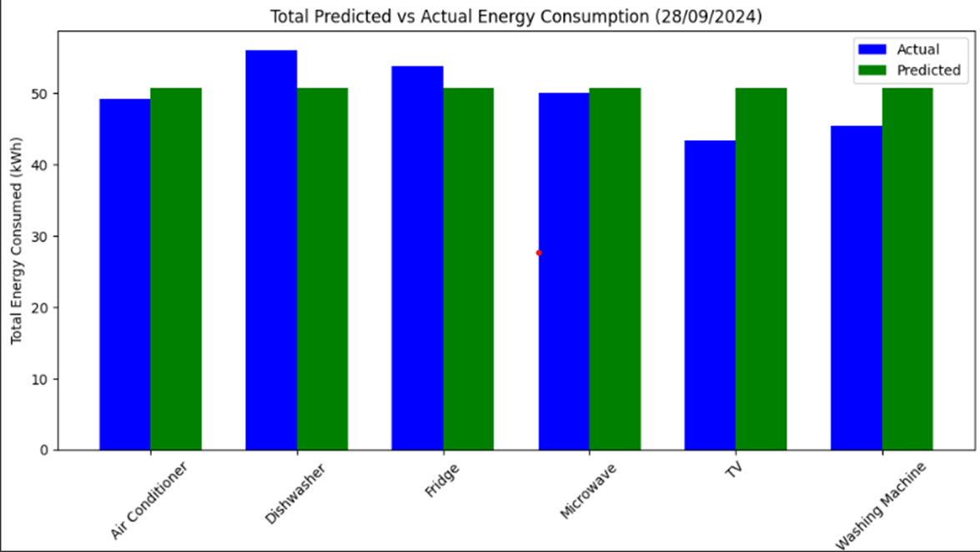
MODULE 4 - MODEL EVALUATION
OUTPUT SCREENSHOT:
www.reallygreatsite.com
PAGE: 04

Slide 25
MODULE 5 - DATA VISUALIZATION
ALGORITHM:
1.Filter Data: Select energy consumption data for the target date or group by 'Time Interval' and 'device’.
2.Bar Plot for Appliance Consumption: Create a bar chart showing total energy consumption by appliance.
3.Pie Chart for Total Consumption: Visualize energy distribution across appliances with a pie chart.
4.Bar Plot for Time Intervals: Generate bar charts for each time interval showing appliance energy use.
5.Display Visuals: Format and present charts with labels, titles, and colour schemes for clarity.
PAGE: 08

Slide 26
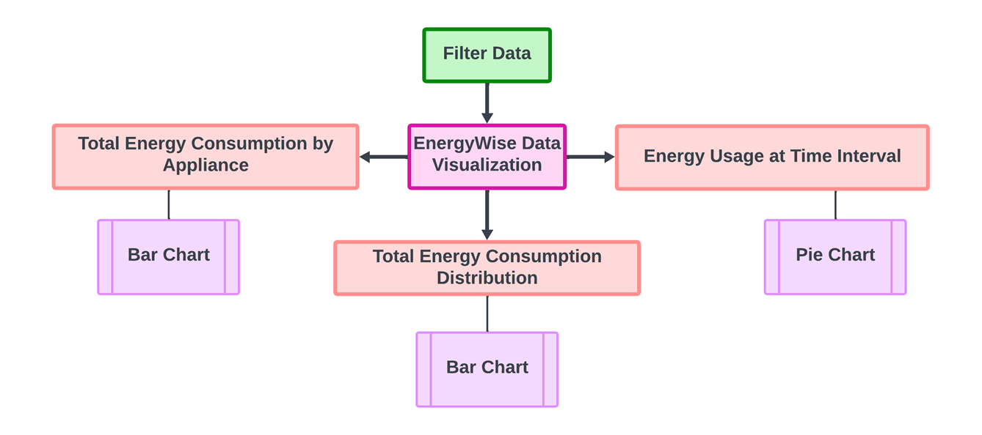
MODULE 5 - DATA VISUALIZATION
DATA FLOW DIAGRAM
www.reallygreatsite.com
PAGE: 04

Slide 27
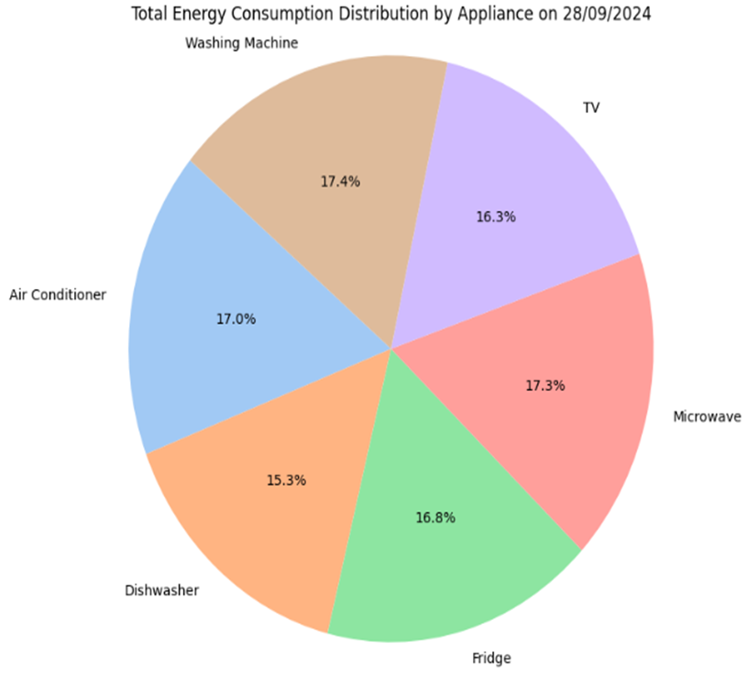
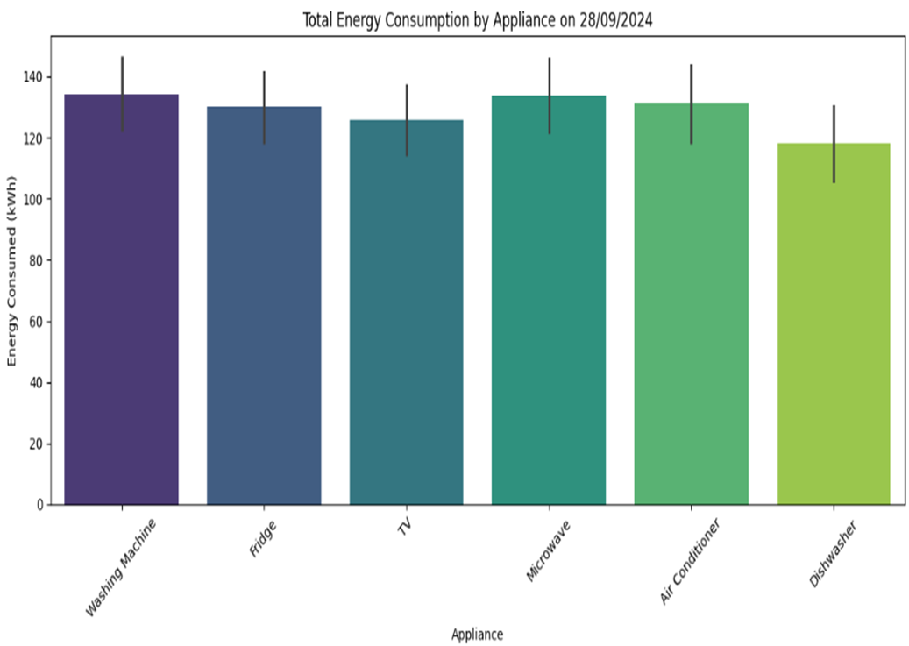
MODULE 5 - DATA VISUALIZATION
OUTPUT SCREENSHOT:
www.reallygreatsite.com
PAGE: 04

Slide 28
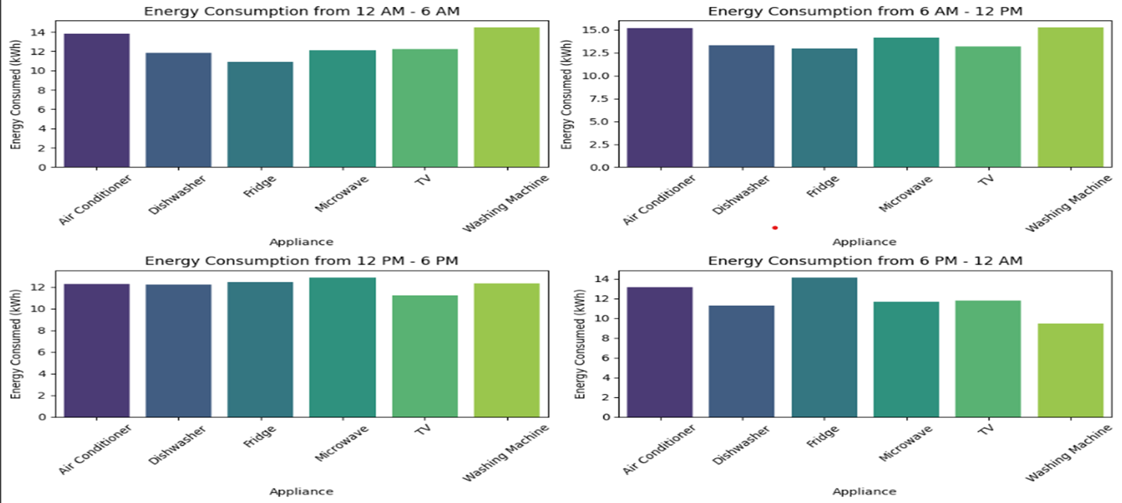
MODULE 5 - DATA VISUALIZATION
OUTPUT SCREENSHOT:
www.reallygreatsite.com
PAGE: 04

Slide 29
MODULE 6 - ALERTS & NOTIFICATION
ALGORITHM:
1.Calculate Total Consumption: Sum the total energy consumption (energy_consumed) for the day.
2.Check Consumption Limit: Compare the total consumption against a predefined limit (e.g., 222 kWh).
3.Trigger Alert: If the consumption exceeds the limit, generate and display an alert with the current consumption and amount due.
4.Display Results: Print the total energy consumed and present the alert message with clear formatting in the output.
PAGE: 08

Slide 30
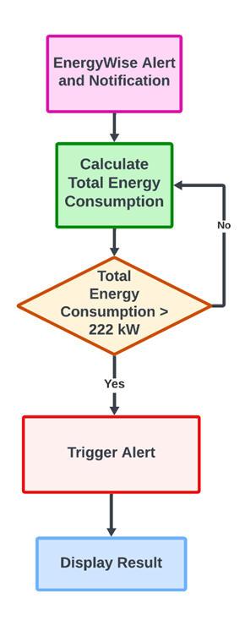
MODULE 6 - ALERTS & NOTIFICATION
DATA FLOW DIAGRAM
www.reallygreatsite.com
PAGE: 04

Slide 31
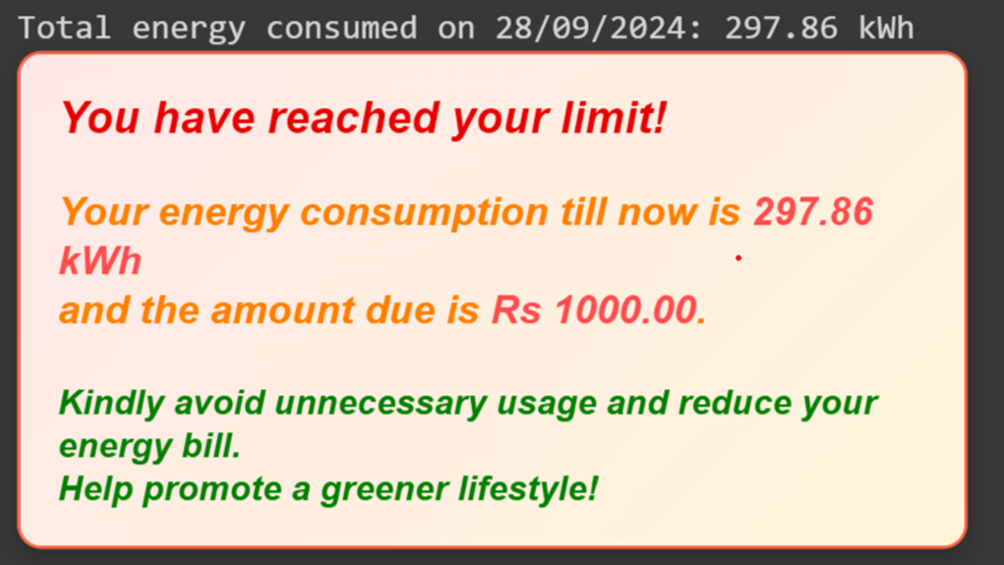
MODULE 6 - ALERTS & NOTIFICATION
DATA FLOW DIAGRAM
PAGE: 04

Slide 32
REFERENCES
[1] L. H. M. Truong, K. H. K. Chow, R. Luevisadpaibul, G. S. Thirunavukkarasu, M. Seyedmahmoudian, B. Horan, S. Mekhilef, and A. Stojcevski, "Accurate Prediction of Hourly Energy Consumption in a Residential Building Based on the Occupancy Rate Using Machine Learning Approaches," *Applied Sciences*, vol. 11, no. 5, pp. 2229, Mar. 2021. doi: 10.3390/app11052229.
[2] Z. Wang, T. Hong, H. Li, et al., "Predicting city-scale daily electricity consumption using data-driven models," *Adaptive Energy*, vol. 16, no. 1, pp. 100025, May 2021. doi: 10.1016/j.adapen.2021.100025.
[3] J. L. Harris and L.-M. Liu, "Dynamic structural analysis and forecasting of residential electricity consumption," *Economics and Forecasting*, P.O. Box 15.51 (Mail Code 5A5), Carolina Power and Light Company, Raleigh, NC 27602, USA, and Department of Information and Decision Sciences, College of Business Administration (MIC 294), The University of Illinois at Chicago, Box 4348, Chicago, IL 60680, USA.
[4] R. K. Jain, K. M. Smith, P. J. Culligan, and J. E. Taylor, "Forecasting energy consumption of multi-family residential buildings using support vector regression: Investigating the impact of temporal and spatial monitoring granularity on performance accuracy," *Journal Name*, vol. XX, no. YY, pp. ZZ-ZZ, Month Year. doi: 10.XXXX/XXXXXX.
[5] Y.-S. Kim and J. Srebric, "Impact of occupancy rates on the building electricity consumption in commercial buildings," *Energy and Buildings*, vol. XX, pp. 7235, Dec. 2016. doi: 10.1016/j.enbuild.2016.12.056.
[6] D. L. Marino, K. Amarasinghe, and M. Manic, "Building energy load forecasting using deep neural networks," *Department of Computer Science, Virginia Commonwealth University, Richmond, Virginia*, Email: marinodl@vcu.edu, amarasinghek@vcu.edu.
www.reallygreatsite.com
PAGE: 04

Slide 33

THANK YOU

